Slide 1


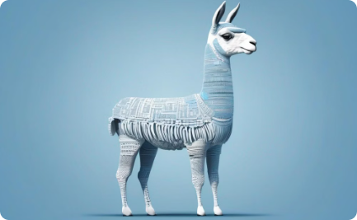

Data-driven Healthcare Solutions in the Digital Age
LLM-Powered Medical Chatbot
Data-Driven Insights
Llama: Powerful LLM
Unlock the value of healthcare data through advanced analytics and visualization to drive better outcomes and improve decision-making.
Explore the capabilities of Llama, an open-source large language model, and how it can be integrated into healthcare applications.
Leverage the power of large language models to build an intelligent medical chatbot that can assist patients and healthcare providers.

Slide 2
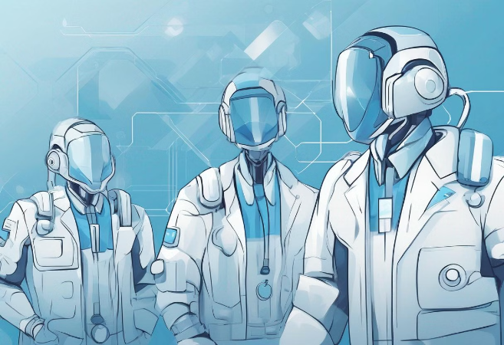
Agenda
Introduction
Core Technologies
Benefits of LLM-Powered Medical Chatbots
Building the Medical Chatbot
Challenges and Solutions
Case Studies and Examples
Interactive Demo
Q&A Session
Conclusion

Slide 3
Importance of Data-Driven Healthcare
Transformation of Healthcare
Role of Digital Technologies
Use of big data and analytics to improve patient outcomes
Telemedicine, wearable devices, and mobile health apps
Personalized medicine tailored to individual patient profiles
Integration of electronic health records (EHRs) for better coordination

Slide 4

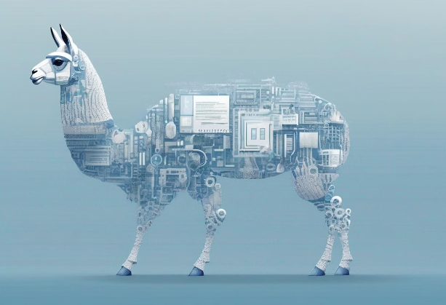
Understanding Llama
Powerful Language Model
Llama is a large language model designed for natural language understanding and generation. It is capable of processing and generating human-like text.
Crucial for Healthcare
In healthcare, Llama helps in understanding complex medical queries, generating appropriate responses, and processing intricate medical texts.
Driving Innovation
By harnessing Llama's capabilities, healthcare providers can streamline operations, improve patient experiences, and make more informed decisions.

Slide 5
Understanding LangChain
LangChain is a framework that facilitates the integration of large language models with external data sources. This allows for seamless connectivity with databases, APIs, and other data repositories, enabling language models to access dynamic, real-time information.
The key benefits of using LangChain for chatbot development include the ability to provide accurate and up-to-date information to users, as the chatbot can dynamically retrieve data from various sources. This enhances the overall user experience and the chatbot's ability to deliver relevant and helpful responses.

Slide 6
Understanding Chainlit
What is Chainlit?
Chainlit is a powerful tool for creating and managing conversational interfaces with large language models.
Capabilities for Managing Conversational Interfaces:
Chainlit offers a user-friendly interface design, robust conversation tracking, and advanced management features.
Integration with LLMs:
Chainlit is easy to set up with models like Llama, enabling quick deployment of conversational applications.

Slide 7
The Benefits of LLM-Powered Medical Chatbots
LLM-powered medical chatbots offer enhanced patient support and engagement by providing 24/7 availability to answer queries and delivering personalized responses based on patient history and preferences.
These chatbots also improve efficiency and accessibility, reducing the workload on healthcare providers and increasing access to medical information and advice, especially in underserved areas.
Additionally, by integrating with electronic health records (EHRs), the chatbots can leverage patient data to provide tailored advice and leverage predictive analytics to anticipate patient needs and suggest timely interventions.

Slide 8
Setting Up the Environment
To get started with the LLM-powered medical chatbot, you'll need to set up the following environment:
First, you'll need a Python programming environment. This can be easily set up by downloading and installing the latest version of Python from the official website: https://www.python.org/downloads/
Next, you'll need to install the necessary libraries using pip, the Python package installer. Run the following command in your terminal or command prompt:
pip install llama
langchain
chainlit
Finally, we recommend setting up a development environment, such as PyCharm or Visual Studio Code, to make it easier to write, test, and debug your code.

Slide 9
Integrating Llama for Medical Data
Integrating the Llama language model into your medical chatbot application involves a few key steps. First, you'll need to load the pre-trained Llama model onto your system. This can be done using the provided LlamaModel class from the llama library, as shown in the example code:
from llama import LlamaModel model = LlamaModel.load('path_to_pretrained_model')
Once the base Llama model is loaded, the next step is to fine-tune it using your domain-specific medical data. This helps the model learn the nuances and terminology relevant to the healthcare industry, allowing it to provide more accurate and contextual responses. You can fine-tune the model using the provided fine_tune method:
model.fine_tune('path_to_medical_data')
After loading and fine-tuning the Llama model, you can begin integrating it into your chatbot application. The example code snippets provided show how to load and interact with the model programmatically. By following these steps, you can leverage the power of Llama to create a highly capable and knowledgeable medical chatbot assistant.

Slide 10
Using LangChain for Data Connection
LangChain provides a powerful framework for connecting to various healthcare databases and APIs, enabling seamless integration of data sources to power your applications.
To get started, you can set up connections to electronic health record (EHR) systems, medical databases, and APIs using the built-in data connector functionality. This allows you to fetch the relevant data needed for your application, as demonstrated in the example code:
from langchain import DataConnector
connector = DataConnector()
data = connector.fetch_data('api_endpoint')
LangChain supports a wide range of integrations, including public health databases, clinical trial databases, and more. By leveraging these data sources, you can build applications that provide comprehensive, data-driven insights to healthcare professionals and patients.

Slide 11
Creating the Chat Interface with Chainlit
Building an effective chat interface is a key step in developing a successful medical chatbot application. Chainlit provides a powerful framework for creating user-friendly and secure chat experiences.
First, you'll need to set up the chat interface by designing an intuitive layout and UI elements that enhance the overall user experience. This can be accomplished through Chainlit's chat interface components, as shown in the example code:
from chainlit import Chatbot bot = Chatbot(model=model) bot.run()
Beyond the visual design, it's crucial to ensure that the chat interactions are both user-friendly and secure. This involves implementing robust security measures, such as encryption and authentication, to protect the sensitive medical information being exchanged. By focusing on both the user experience and security aspects, you can create a chat interface that instills trust and confidence in your medical chatbot application.

Slide 12
Testing and Deployment
Testing Scenarios:
- Creating test cases for different medical queries.
- Conducting user acceptance testing (UAT) with healthcare professionals.
Deployment Options:
- Cloud deployment (e.g., AWS, Azure, GCP).
- On-premise deployment for healthcare institutions with specific needs.

Slide 13
Challenges and Solutions
Ensure Data Privacy and Security (HIPAA Compliance):
Encrypt data and implement secure storage practices.
Conduct regular audits and compliance checks.
Maintain Accuracy and Reliability:
Continuously train the model with updated medical data.
Implement feedback loops from healthcare professionals.
Build User Trust and Adoption:
Communicate transparently about data use and policies.
Clearly demonstrate the benefits and ease of use to encourage adoption.

Slide 14
Case Studies and Examples
Highlight Successful Implementations:
- Real-world examples of medical chatbots in use.
- Success stories from healthcare providers.
Lessons Learned and Best Practices:
- Key takeaways from successful implementations.
- Best practices for deploying and managing medical chatbots.

Slide 15
Interactive Demo
This interactive demo will showcase the full capabilities of our chatbot. We'll start with a walkthrough, highlighting the various features and functionalities that the chatbot offers. Then, we'll invite all participants to engage with the chatbot directly, encouraging you to ask questions and put the system to the test.
Through this live demonstration, you'll be able to witness the chatbot's responsiveness, its ability to understand and address your queries, and the breadth of information it can provide. We're excited to showcase how this technology can revolutionize the way you interact with and access healthcare-related information.

Slide 16
Q&A Session
Open floor for questions

Slide 17




Slide 18
Key Takeaways
Revolutionize Healthcare with LLMs
Personalized medical advice and streamlined administrative tasks through AI-powered chatbots.
Enhance Patient Outcomes
LLM-powered chatbots improve workflow efficiency and deliver cost savings for healthcare providers.
Innovative Applications
As the technology evolves, expect to see more ways to put patient needs first.

Slide 19
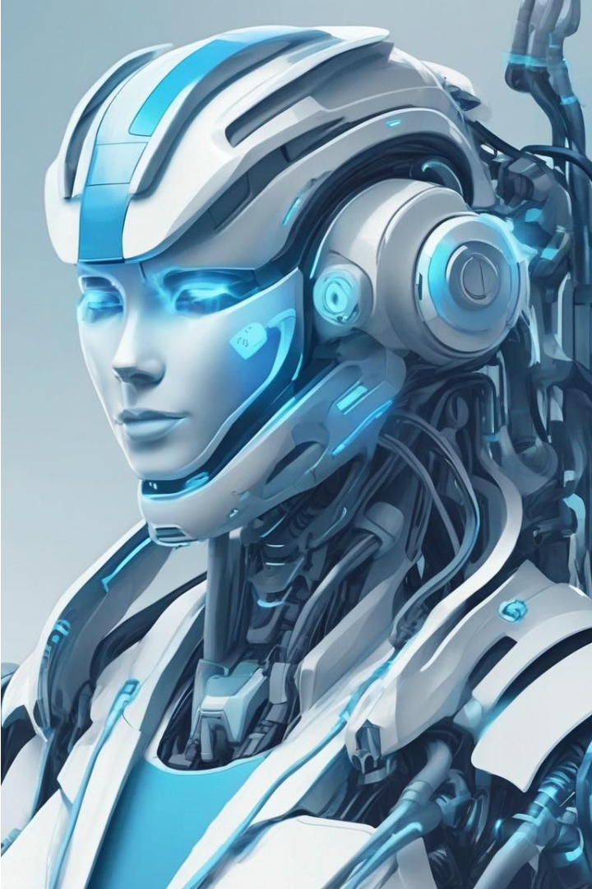
Thank You for Listening 😊
Thank you all for your time and attention today. We're excited to see how LLM-powered chatbots will transform healthcare. Please reach out if you have any further questions.

Slide 20
Dive Deeper: Resources and Further Reading
To continue your exploration of LLM-powered medical chatbots, we've compiled a wealth of resources:
Python Documentation: Learn the fundamentals of the Python programming language, the foundation for our chatbot development.
Llama Documentation: Dive into the technical details of the Llama language model and how to integrate it into your applications.
LangChain Documentation: Discover the LangChain framework and how it simplifies the process of building complex, LLM-powered applications.
Chainlit Documentation: Explore the Chainlit platform and its features for creating beautiful, interactive user interfaces for your chatbot.
Healthcare Data Resources: Explore relevant databases, APIs, and other data sources to enhance the medical knowledge and capabilities of your chatbot.

